Slide 1
EN 410 Energy Management
Gurubalan Annadurai
guru.a@iitb.ac.in

Slide 2
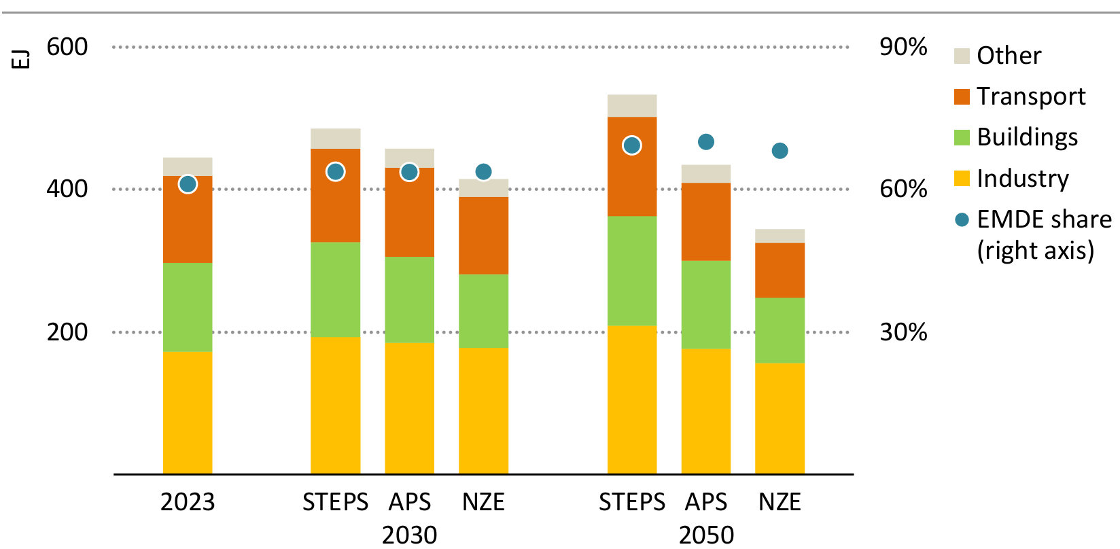
Energy demand across sectors

Slide 3
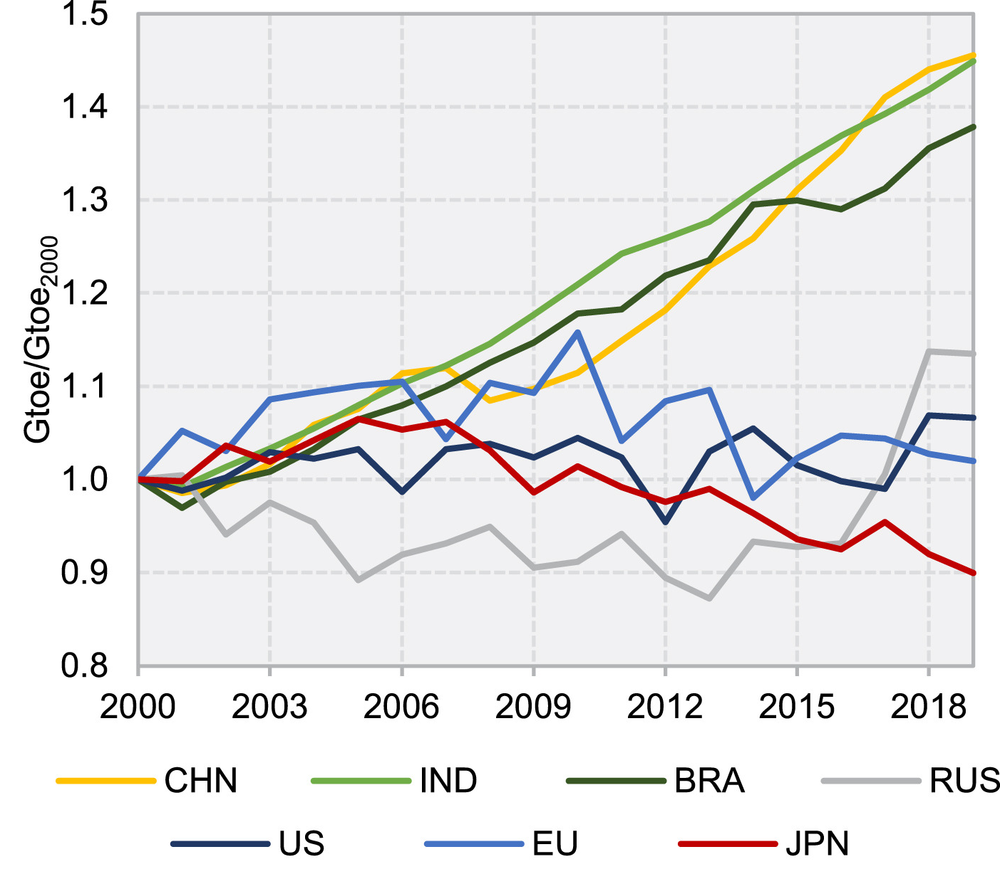
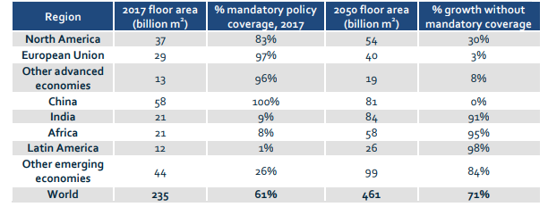
Why India?

Slide 4
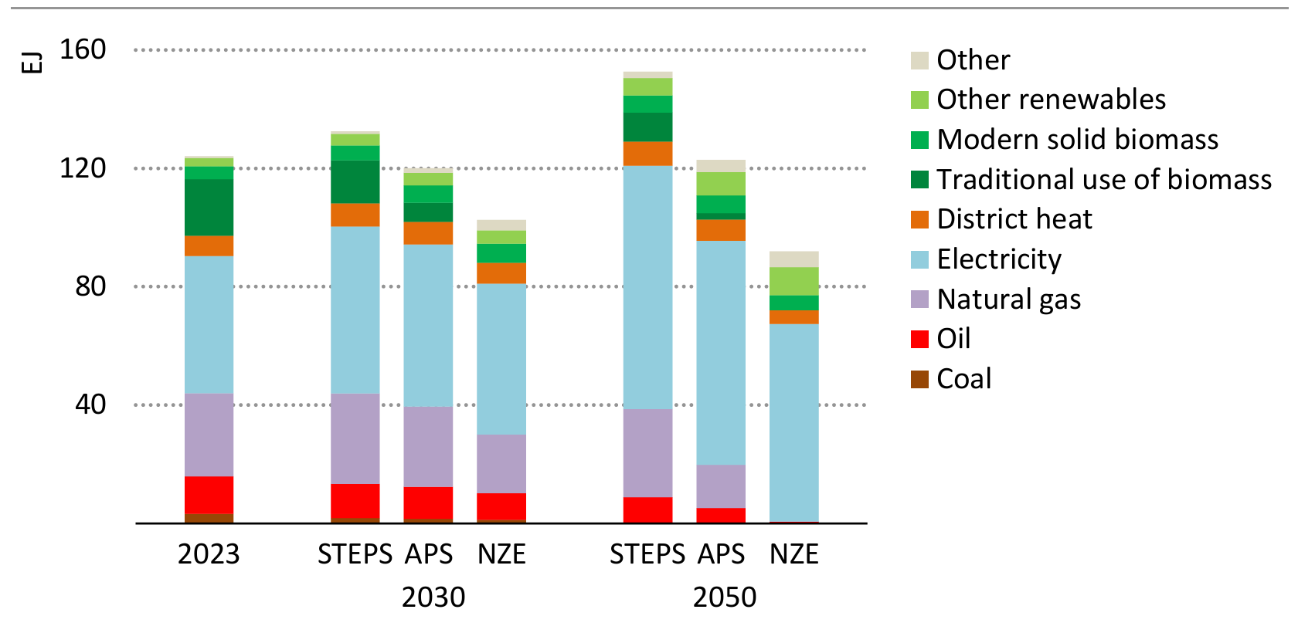
Building energy demand
What is the problem

Slide 5
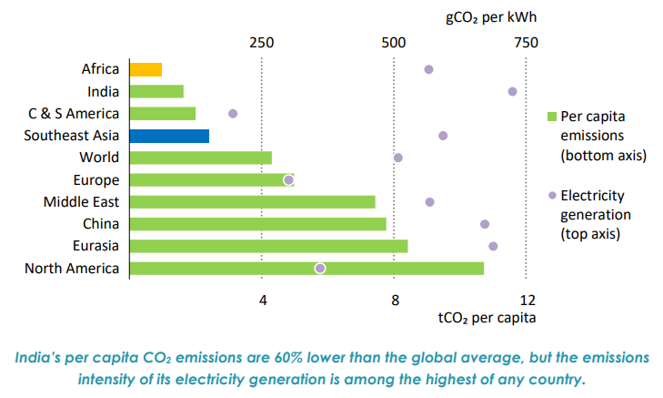
Why India?

Slide 6
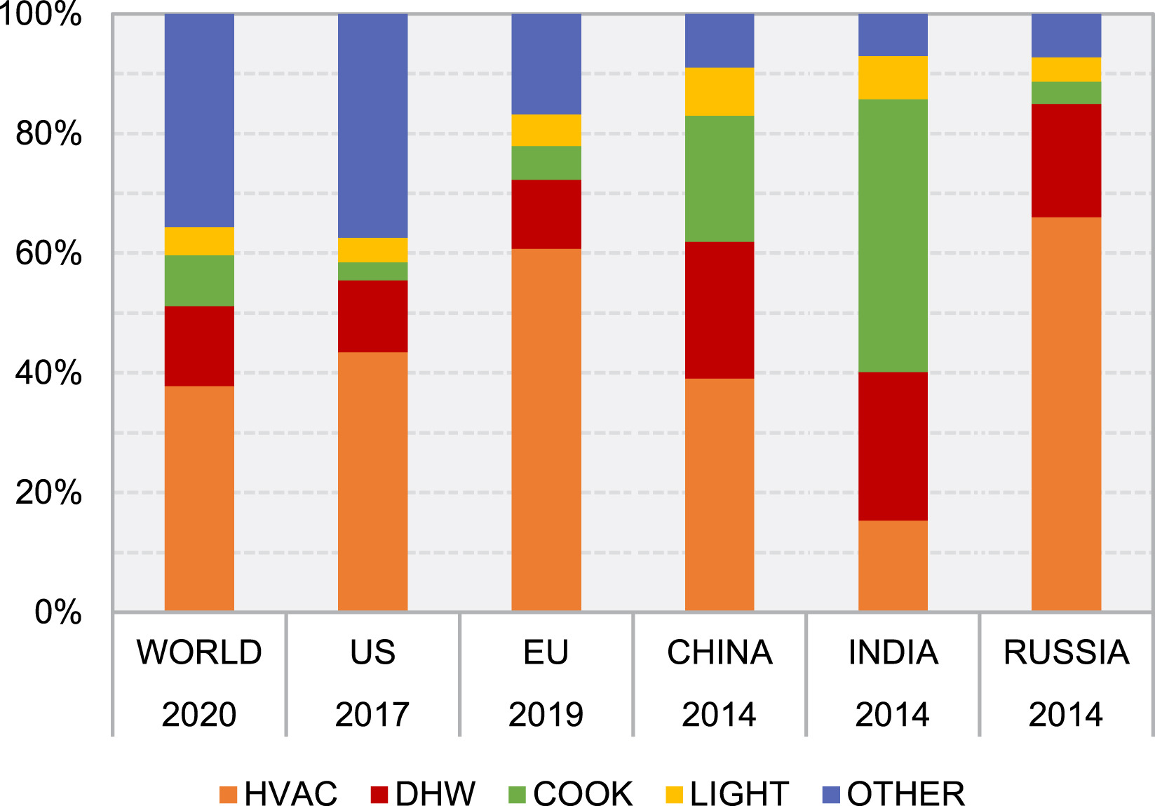
End use intensity global and across countries

Slide 7
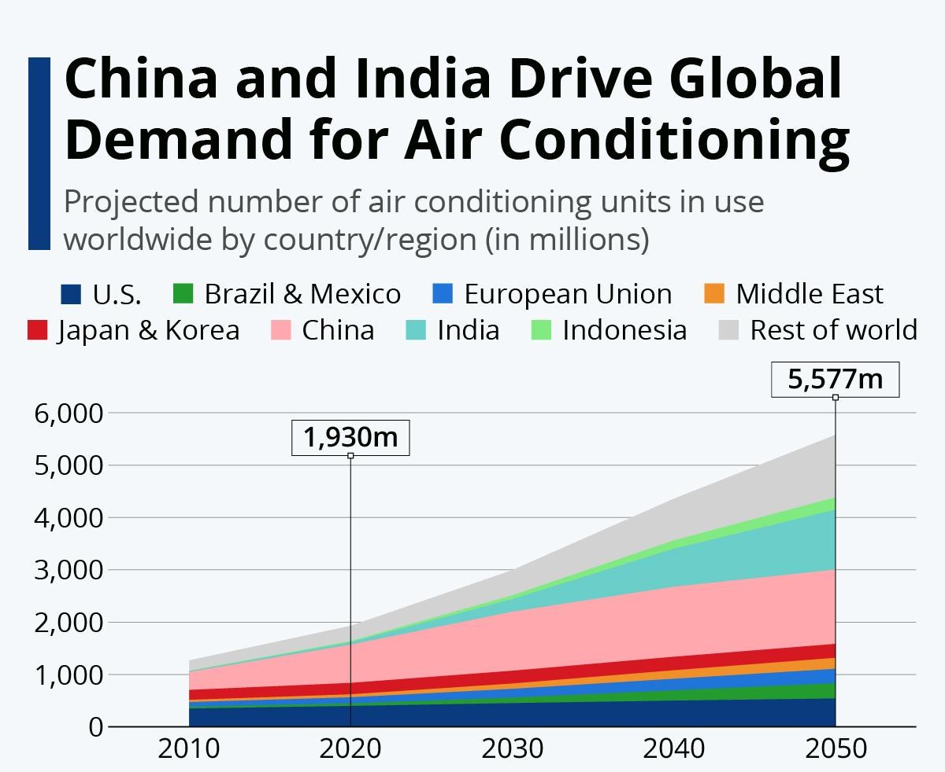
HVAC systems
World's air conditioners and fans – 10% global electricity consumption.
Energy demand for space cooling has risen at an average pace of 4% per year since 2000, twice as quickly as for lighting or water heating
Higher energy consumption for space cooling particularly affects peak electricity demand, especially during hot days when equipment is used at full capacity.

Slide 8
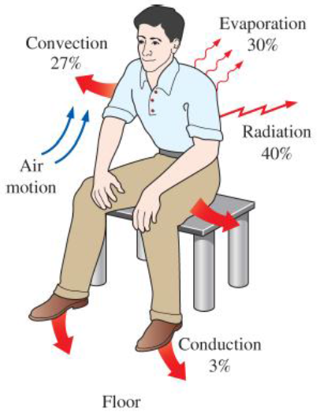
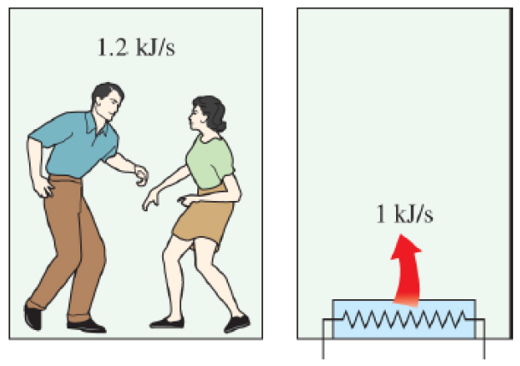
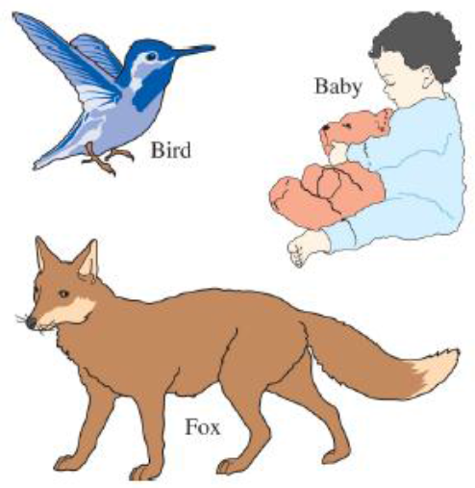
Why we need HVAC system?
Most animals come into this world with built-in insulation, but human beings come with a delicate skin.
Two fast-dancing people supply more heat to a room than a 1-kW resistance heater.
Mechanisms of heat loss from the human body and relative magnitudes for a resting person.

Slide 9
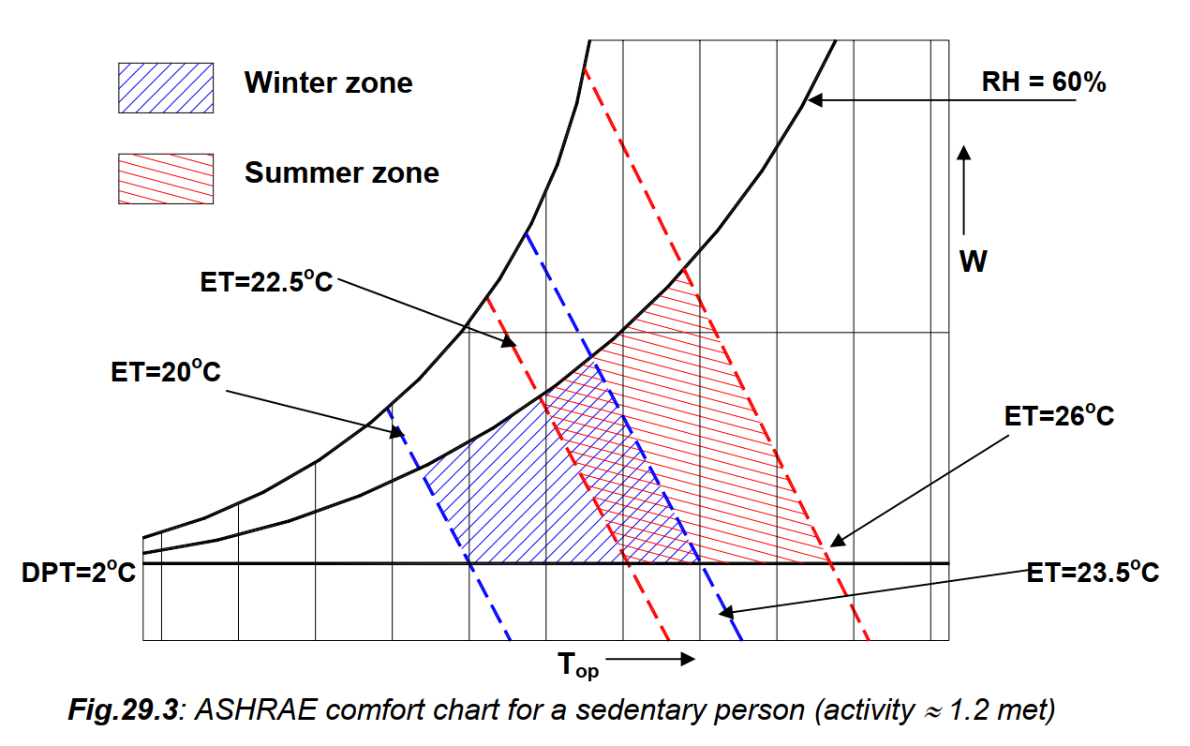
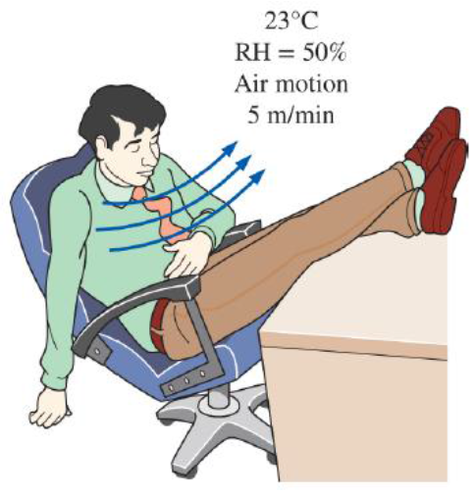
Comfort Chart
A thermally comfortable environment.

Slide 10
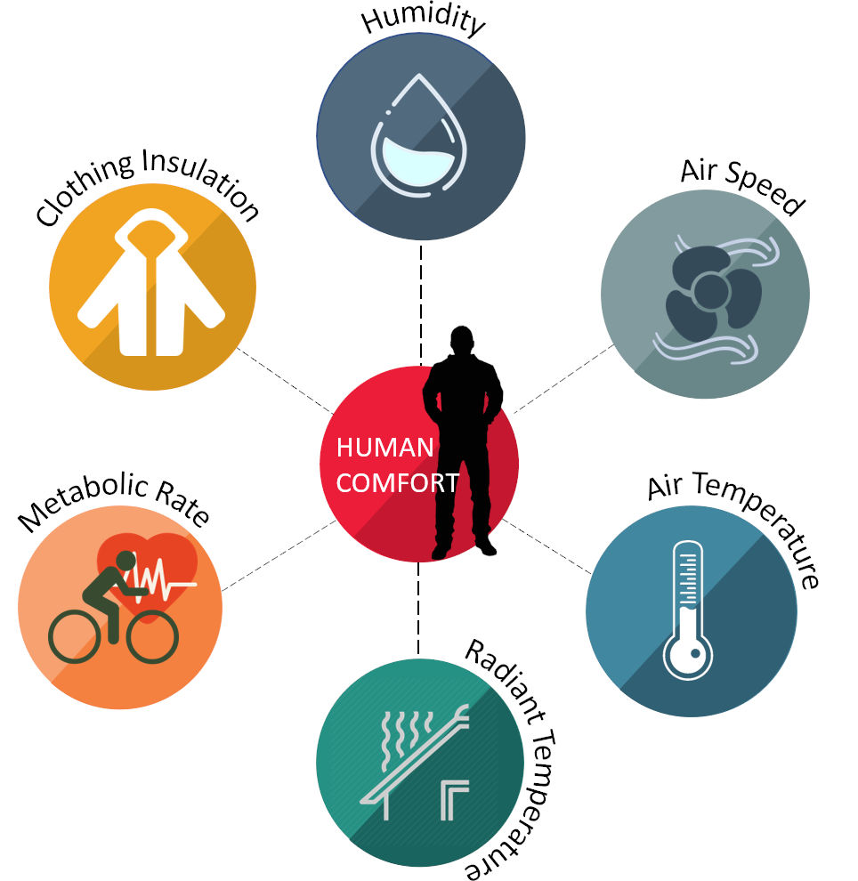
Thermal comfort

Slide 11
Purpose of HVAC system
The purpose of comfort air conditioning is to provide an artificial environment in a given volume irrespective of ambient conditions as required for comfort and welfare of occupants by controlling dry-bulb temperature (DBT), humidity, air movement, cleanliness, noise level, etc.

Slide 12
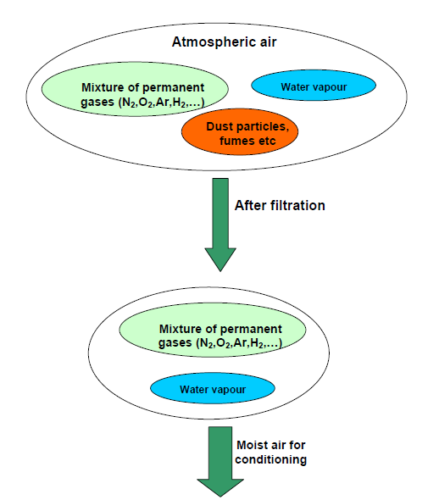
Psychometrics
Moisture air – Dry air (Nitrogen, oxygen, argon, CO₂, etc. ) + Water vapor (varies with T and P)
Dry bulb temperature
Saturated vapor pressure
Relative humidity
Specific humidity
Specific volume
Enthalpy
How many properties needed to define the state?
From Gibb's phase rule, number of independent thermodynamic properties (N) required to define the state of mixture is given by,
N = C + 2 – P
Where, C is number of components (2; dry air and water vapour) and P is number of phases (1; gaseous).

Slide 13
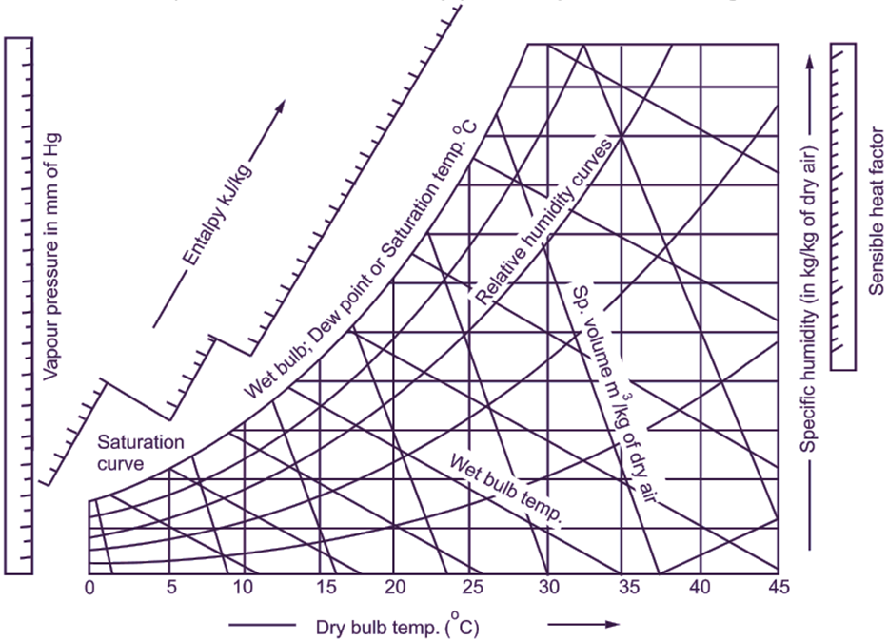
Psychometric Chart
Wet bulb temperature

Slide 14
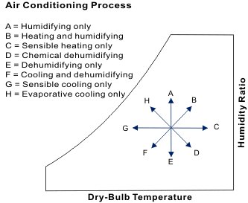
Psychometric process
 | T | W
A
B
C
D
E
F
G
H

Slide 15
Psychometric process
How do estimate the energy transfer in each process
B and F are the major air conditioning process

Slide 16
References
https://www.trane.com/content/dam/Trane/Commercial/global/products-systems/education-training/engineers-newsletters/airside-design/admapn020en-0406.pdf
https://nzeb.in/knowledge-centre/hvac-2/radiant-cooling-systems/
NPTEL, Mechanical Engineering - Refrigeration and Air Conditioning
https://archive.nptel.ac.in/courses/112/105/112105129/
Karthik Panchabikesan, Kumaresan Vellaisamy, Velraj Ramalingam, Passive cooling potential in buildings under various climatic conditions in India, Renewable and Sustainable Energy Reviews, Volume 78, 2017, Pages 1236-1252,
https://climate.earthathome.org/sunlight-stored-in-soil/
https://fairconditioning.org/knowledge/passive-design/shading/
https://www.sciencedirect.com/science/article/pii/S1364032116002665#f0010

